Slide 1
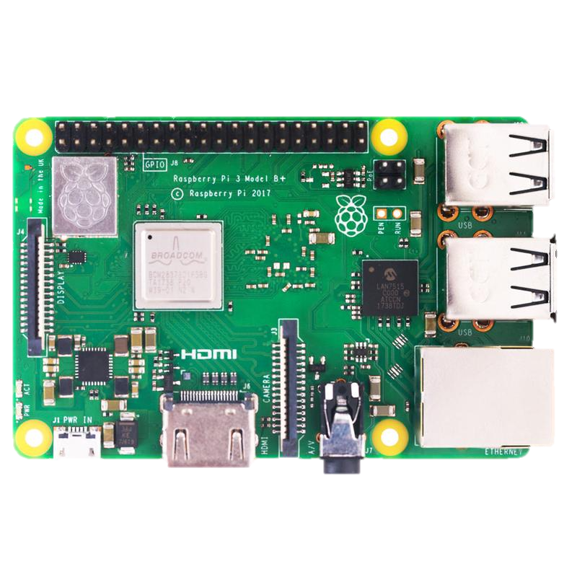
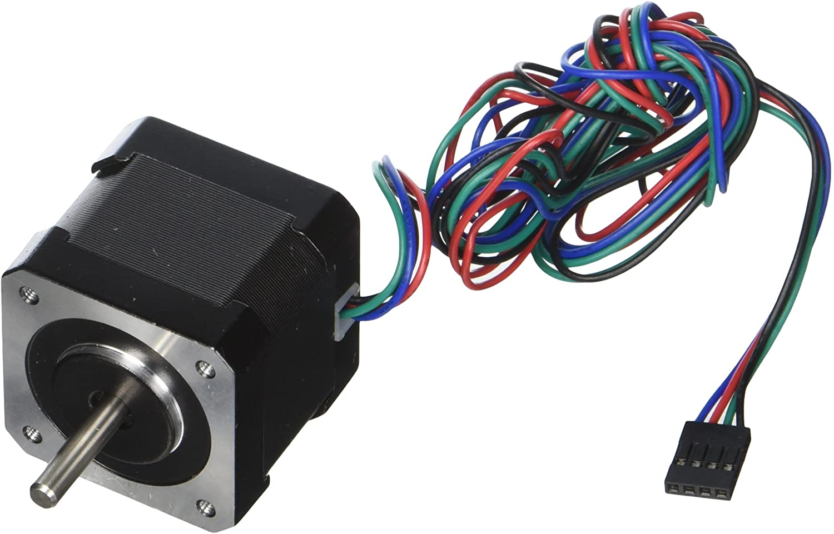
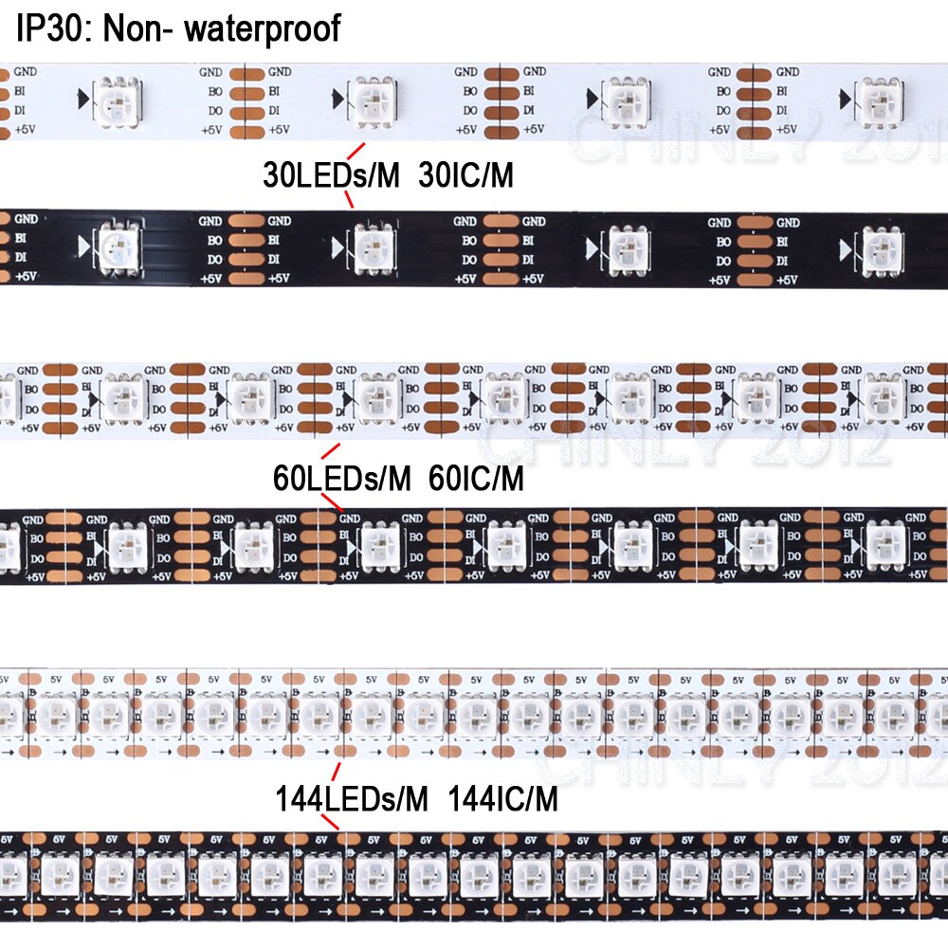
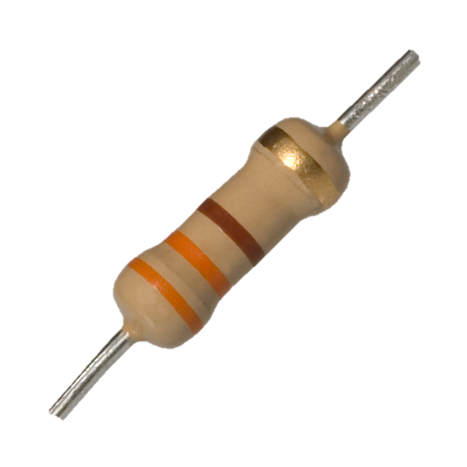
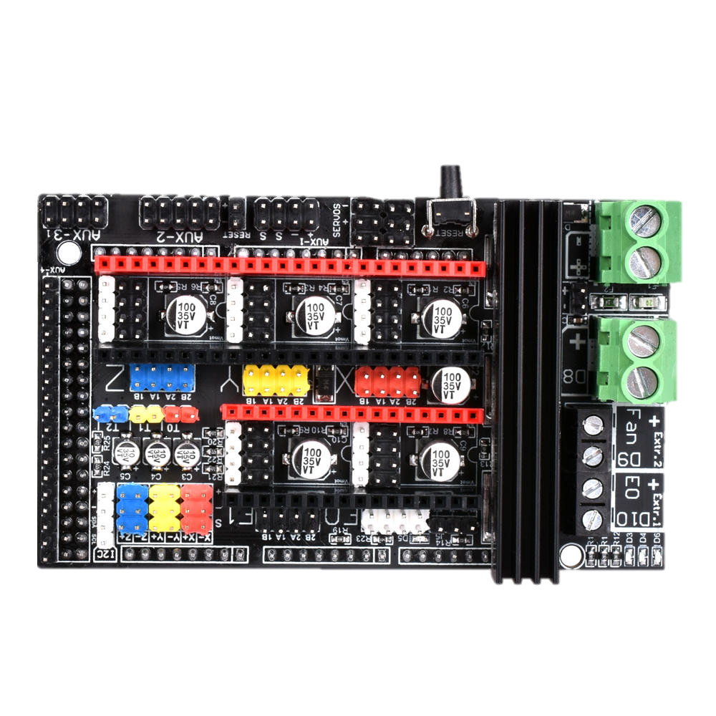
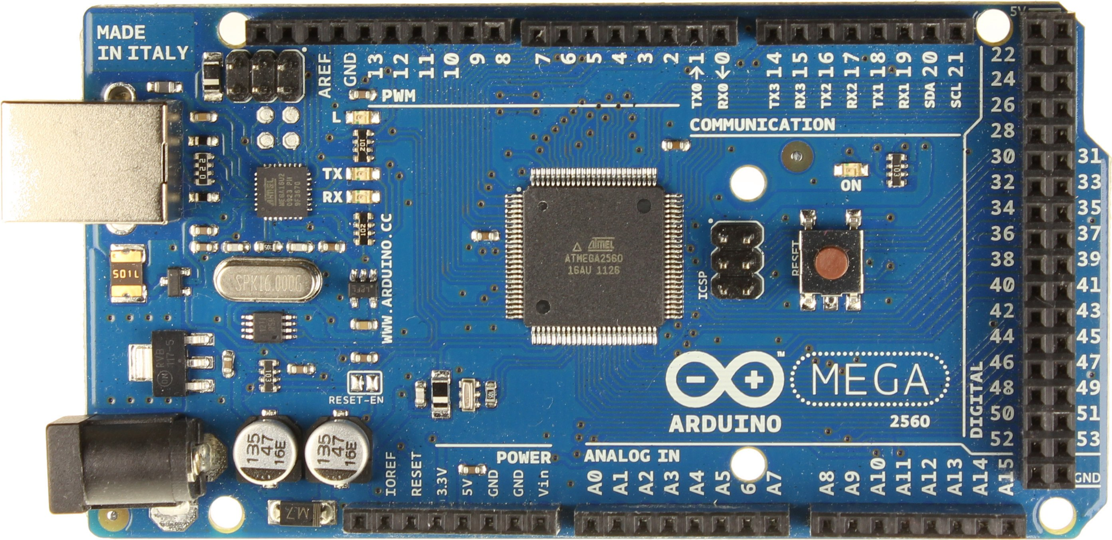
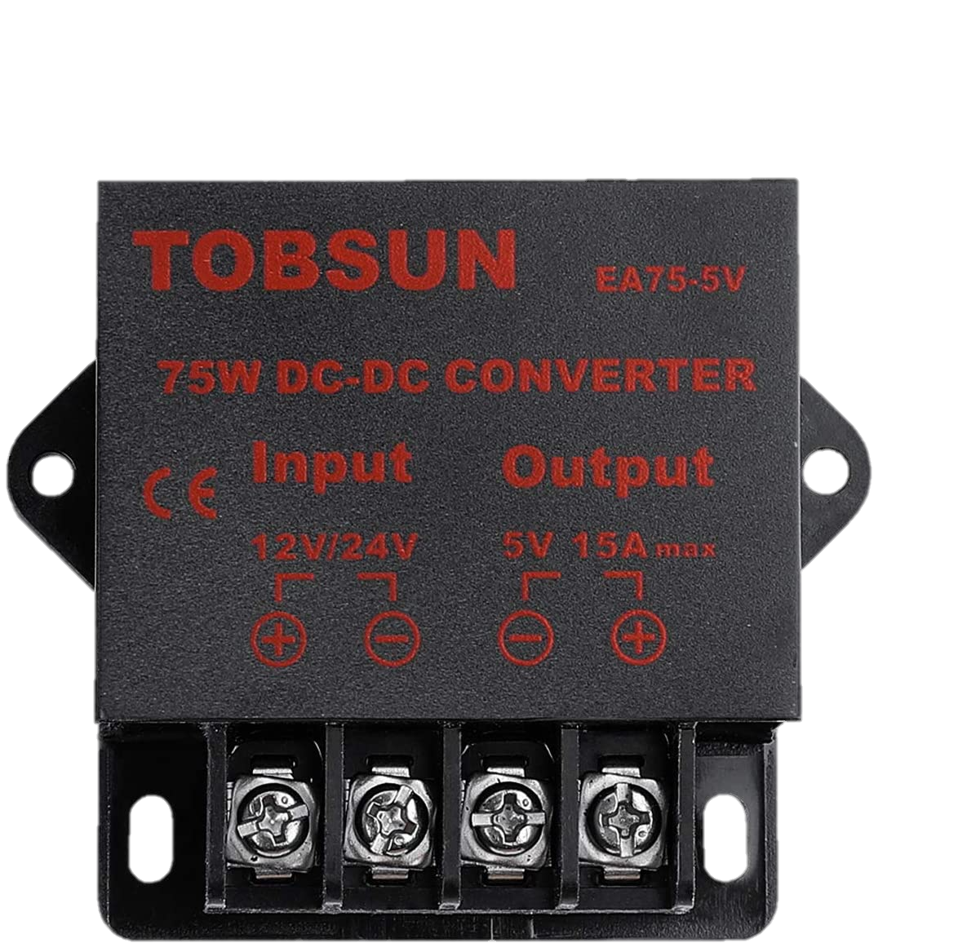
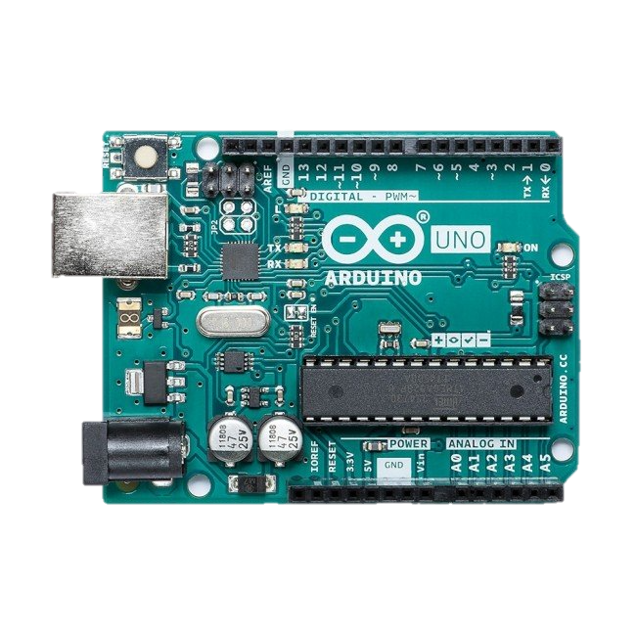
Sand Table Electronics Diagram
https://github.com/rdudhagra/Sand-Table
Do not forget to wire your stepper drivers correctly! If you’re using TMC2209’s, see https://youtu.be/dOJbSrWVu_Q?t=439 (follow instructions for the MKS Gen L and TMC 2209)
Input power (12V)

